Slide 1

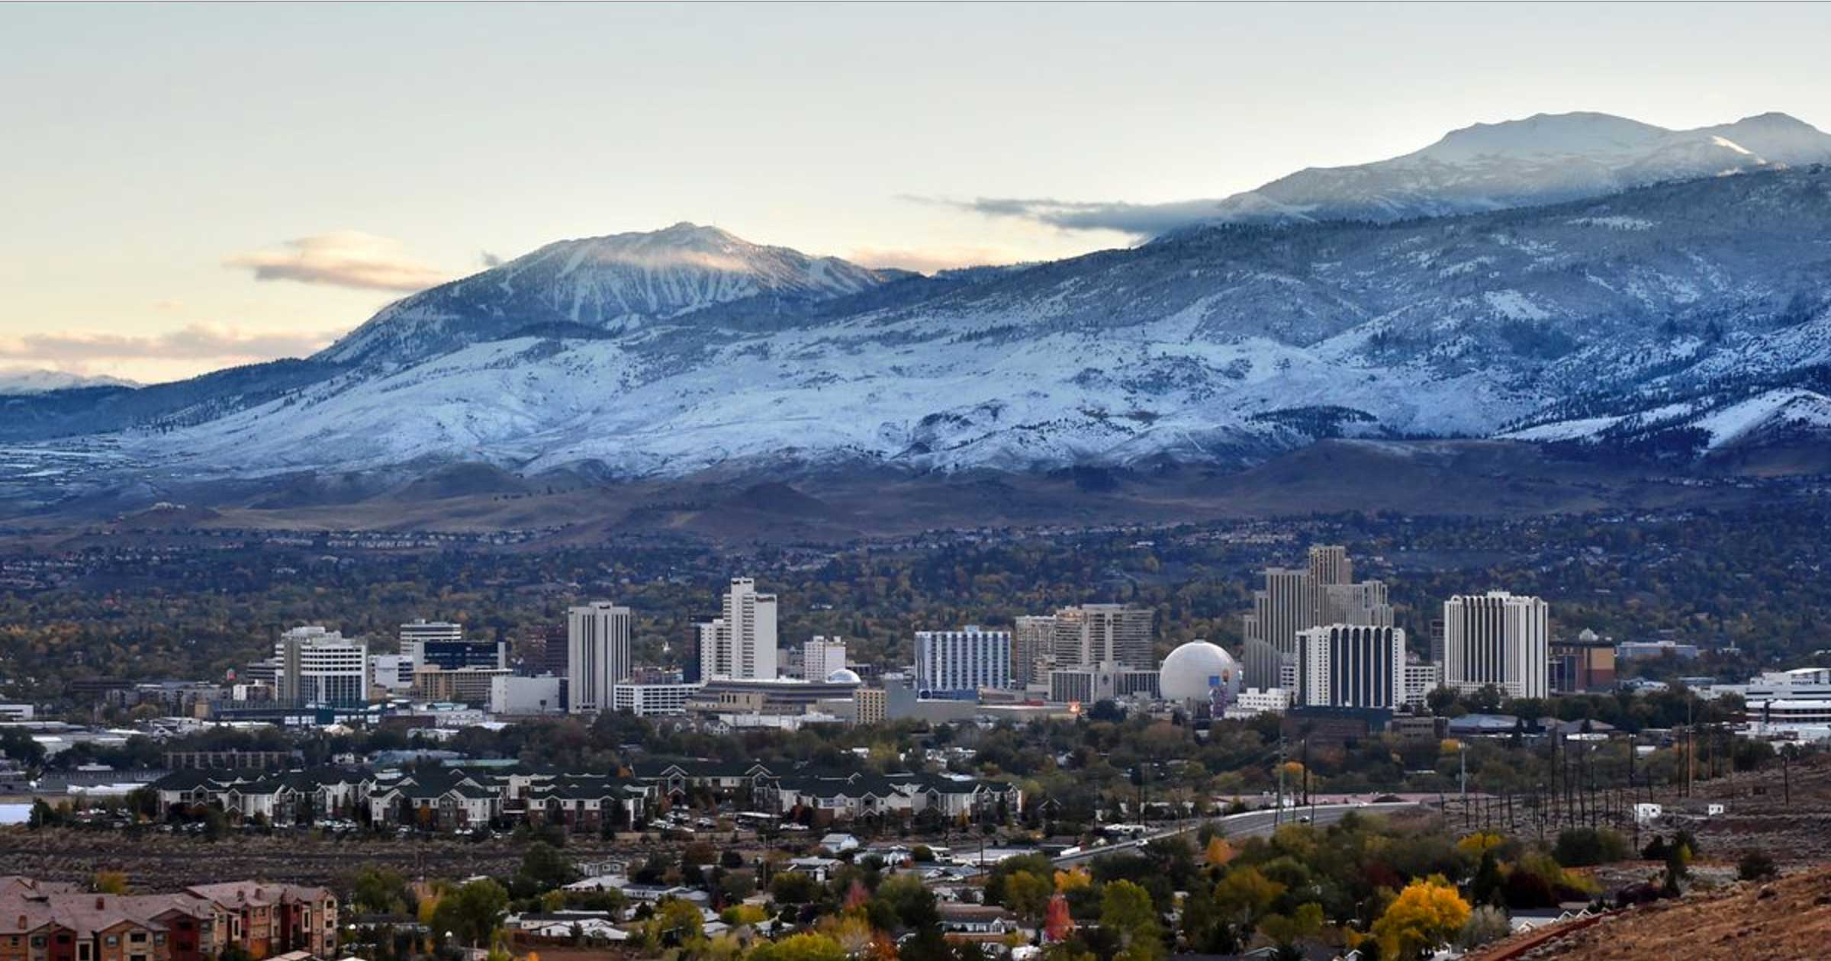
Washoe County
Reducing hazards throughout the region
Regional Hazard Mitigation Plan Update
Notes:
To use this title animation slide with a new image simply 1) move the top semi-transparent shape to the side, 2) delete placeholder image,
3) click on the picture icon to add a new picture, 4) Move semi-transparent shape back to original position, 5) Update text on slide.

Slide 2
DEFINING HAZARD MITIGATION
Our vision
  To reduce the impacts of disasters through adaptable planning and inclusive engagement.
Our guiding principles
  Building a culture of community resilience through effective funding and spending; community outreach and buy-in; and regional collaboration.
A commitment to reduce risks posed by hazards
A comprehensive and inclusive planning process
Development of a mitigation strategy with clear and concrete actions
Goal 1: Invest in adaptable and agile hazard mitigation strategies.
Goal 2: Enhance emergency services capabilities by reducing burden.
Goal 3: Implement strategies through an inclusive process backed by regional cooperation and partnership.
Goal 4: Integrate technology and monitoring into hazard mitigation strategies.
Goal 5: Reduce property damage and minimize repetitive losses from priority hazards.
Goal 6: Promote personal responsibility in reducing risks.

Slide 3
IDENTIFYING OUR HAZARDS
Revealing key points
one at a time enhances comprehension.

Slide 4
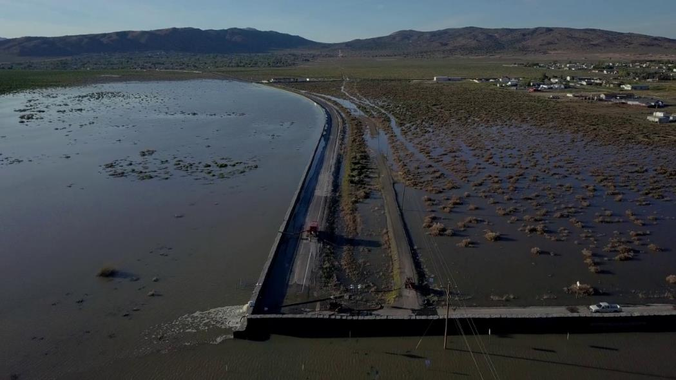
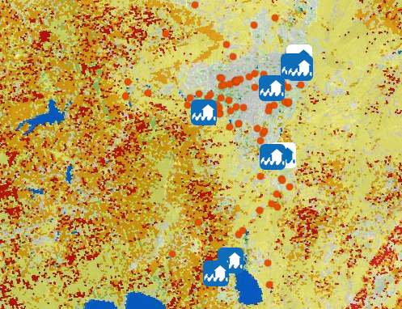
MEASURING IMPACTS
Leaning on field staff and what they’ve seen
Collaborative information sharing
Participatory mapping
Community engagement and empowerment

Slide 5
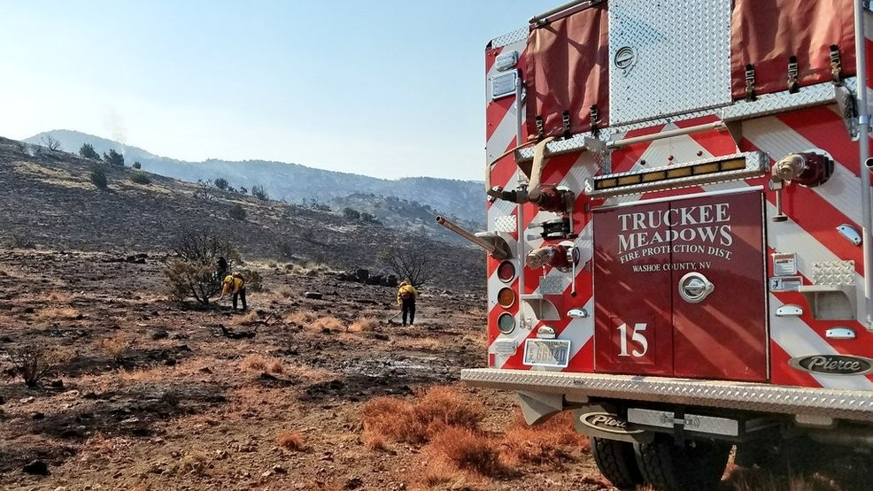
IDENTIFYING SOLUTIONS
Clear articulation of the problem statement and location
Developing actions that address our risks
Incorporation of our goals
Community member ideas and buy-in

Slide 6
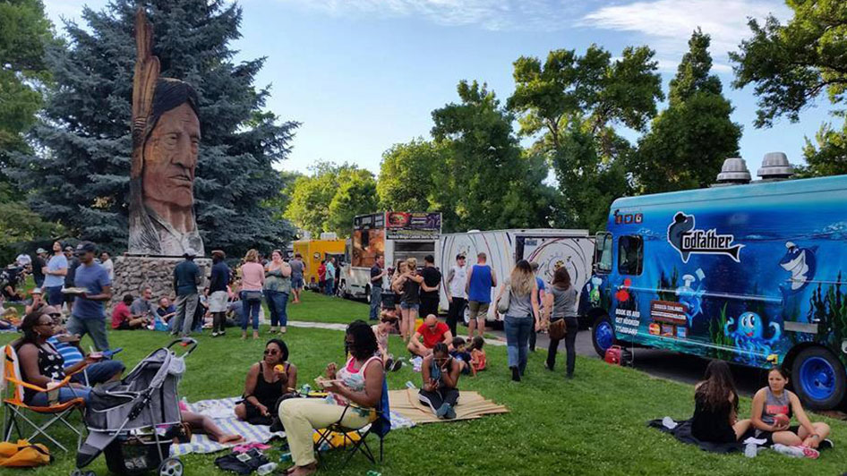
COMMUNITY
ENGAGEMENT
Pushing local participation in online surveys
Identifying community events
Facilitating Public Forums
Take our community survey today!
https://www.surveymonkey.com/r/KBTQXMF

Slide 7
WHAT YOU CAN DO
Review the Draft Plan once available
Identify key areas of risk and mitigation project ideas
Identify community events where we can solicit feedback
Reach out to Zane Beall for more information at zbeall@ene.com

